Slide 1
ML109 Homework 6
MLLO 20210603

Slide 2
Submission
Deadline: 6/16 Wed. 14:00
Submission: Ceiba
File name & format
<學號>.zip, ex. r09900001.zip
(unzip 後須有以下檔案，且不能有其他檔案)
mongo.txt
neo4j.txt
report.pdf
檔案格式錯誤一律扣 10%
(Mac 壓縮多夾帶一層資料夾，此份作業不扣分）
說明：
mongo.txt /neo4j.txt : 各題 mongoDB (part I.) / neo4j (part II.) 的 code
report.pdf : code 截圖 & results
(作業敘述見下兩頁投影片）
Version requirements
MongoDB v3
Neo4j v4

Slide 3
Homework 6 - Forewords: Reminding
To complete this homework, you need to have downloaded the MongoDB server and related client-side programs, and the Neo4j database server and the related client-side programs. The related information has been presented to you in our course notes. You can also find all necessary information from MongoDB and Neo4j’s documentation.
You also need to have practiced and gotten familiar with these technologies, and gotten familiar with how to write MongoDB queries, and the Cypher queries.

Slide 4
Homework 6 (2)
Part I (MongoDB)
Task 1 Load the EE5178 student CSV file - hw6_student_data.csv [link] into collection “students” in database “hw6” in MongoDB, and write a MongoDB query to return the information (the document) about yourself. Note that we did not cover how to load CSV file in our lectures. You are responsible to find out how yourself. (Hint: download and install the MongoDB Database Tools package, and use the mongoimport) (5%)
Task 2: Write a MongoDB query to return the information about you and your peer students. (10%)
Note: The definition of “peer student” is the same in the SQL homework.
For undergraduate students, your peer students are those in the same department and same year as you.
For graduate students, your peer students are those in the same graduate program and same year as your.
peer students 不包含自己。若沒有同系且同年級，就 output empty 並請附註說明
Task 3: For each “系級" in the “students” collection, find out the number of students in it. Write a MongoDB query to return this information (Hint: aggregation. 10%)

Slide 5
Homework 6 (3)
Task 4: For the documents for each student, add a new field “日期", and set the “2021-03-01”. Then return the information about your and your peer students again to make sure your update is successful. (10%)
Task 5: Add the following students into your “students” collection.
Write a query to return yourself and these new students to prove you have successfully inputted the data. (5%)
Note: You are free to choice to input the date using string “2021-03-01”, or as the ISODate() object.
Task 6: (Challenge problem) Design an increment aggregation pipeline to calculate the number of student for each “系級", and store your result in a “tally” document in your “students” collection. Run your query with date as to “2021-03-31” first. Print out the “tally” document. Then run your query again with date set to “2021-06-10”, and print our the “tally” document. (10%)
Hint: you shall need to learn the 2nd half of MongoDB course note well, especially the last three pages.
Reference: { $dateFromString: { dateString: "2017-02-08" } }
Reference: ISODate("2017-02-08T00:00:00Z")
日期 | 身份 | 系所 | 學號 | 姓名
2021-06-02 | 旁聽生 | 歷史系_一年級 | b09900201 | 小花
2021-06-02 | 校內生 | 歷史系_四年級 | b06900332 | 小草
2021-06-02 | 校內生 | 機械系_四年級 | b06502055 | 小天

Slide 6
Homework 6 (2)
Part II (Graph DB Basic)
Task 1: Load the EE5178 student CSV hw6_student_data.csv [link] (the .csv is same as Part I.) into Neo4J graph database and create one node for each students. (5%)
Task 2: Create a “peer” relationship between you and each of your peer students. (10%)
Task 3: Write a Cypher query to return you, and your peer students in a list (10%)
Part III 2 (Graph DB Advanced)
Bonus: Fill out your 5 hobbies in the file hw6_hobbies [link]
before 6/7 Mon. 23:59 (5%)
Task 1: Download the student hobbies hw6_hobbies as CSV and load it into the database and create the “necessary nodes and relationships” (Think carefully how you want to represent hobbies in your GDB.) (5%)

Slide 7
Homework 6 (2)
Now assume you want to expand your hobbies. Logically, you need to first find out all the students in this class who has the at least one common hobbies as you. Let’s call these your “hobby friends”.
The second step is to find other students who have at least one common hobby with your hobby friends, let’s call them “foaf” (friend of a friend). The hobbies of these people are the potential new hobbies you want to acquire.
Task 2: Write a cypher query to print out your “foaf” and their associate new hobbies. (10%)
You yourself should not be in this list. If you yourself appear in this → -4%
Your hobbies of friends should not appear in the hobbies of your foaf. If they do → -4%
Task 3: Write a cypher query to print out
all the new hobbies of your foaf. (10%)
Your old hobbies should not appear in the list. If they do → -4%
There should not be duplicates. If they do → -4%

Slide 8
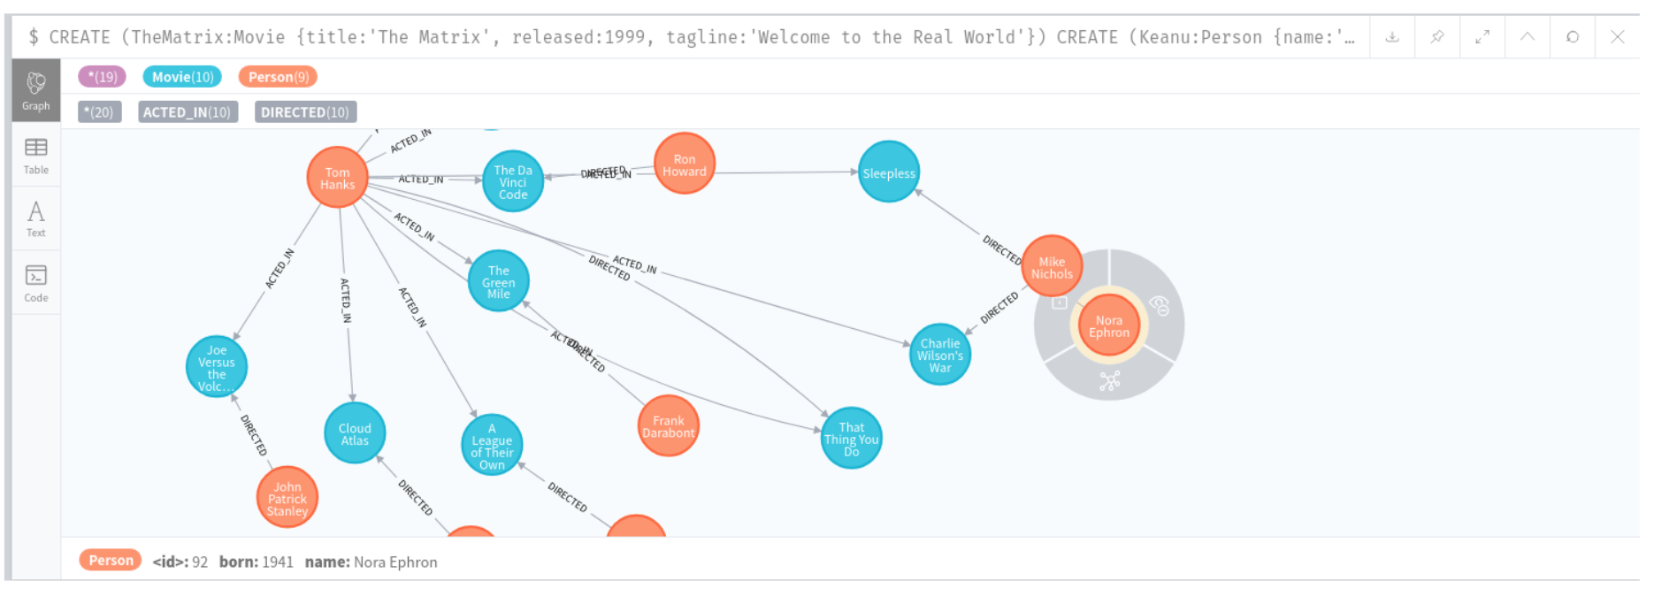
Homework 6 (2)
Part III 2 (Graph DB Advanced) 的部分，report 內容除了包含你的結果以外，還要有簡單的說明/解釋
Neo4j 介面上可以將matching到的subgraph 畫出來，並輸出 .jpg/.png
輸出結果介面中，右上角有下載符號

